Slide 1


Mini Project – Proposal Seminar
On
“DS Resource Hub”
Dept. of CS&E ( DATA SCIENCE)
Adichunchanagiri Institute of Technology
Chikkamagaluru - 577102
Presented By, Under the Guidance
POOJA SHANKAR S(4AI23CD036) Prof . Shilpa K .V
NISHMITHA K M(4AI23CD034)
SPOORTHI H(4AI23CD053)
DHANUSHREE D D(4AI23CD016)

Slide 2
AGENDA
About the project
Motivation
Existing System
Proposed System
Problem Statement
Tools and Technology
Expected Outcomes

Slide 3
About the Project
Develops a centralized web-based hub for the Data Science department.
Stores and organizes academic resources like question papers, project titles, and syllabi.
Allows faculty to securely upload, update, and share materials.
Enables students to easily access and view resources anytime.
Reduces communication gaps and saves time.
Enhances departmental coordination and supports effective learning.

Slide 4
MOTIVATION
Academic resources are scattered and hard to access.
No centralized system for storing departmental materials.
Students struggle to find past papers and updated syllabi.
Faculty repeatedly share the same content with each batch.
A centralized digital solution is needed to improve access, efficiency, and collaboration.

Slide 5
EXISTING SYSTEM
Resources are managed manually or shared via WhatsApp, Google Drive, or printouts.
No proper structure or categorization exists for storing materials.
Time is wasted by students and faculty in locating resources.
The current system is unorganized, inefficient, and prone to data loss.

Slide 6
PROPOSED SYSTEM
The proposed system is a web-based Resource Hub that centralizes all academic data for the Data Science department.
It allows faculty to upload and manage files securely using a structured database.
Students can search and download materials using an organized and user-friendly interface.

Slide 7
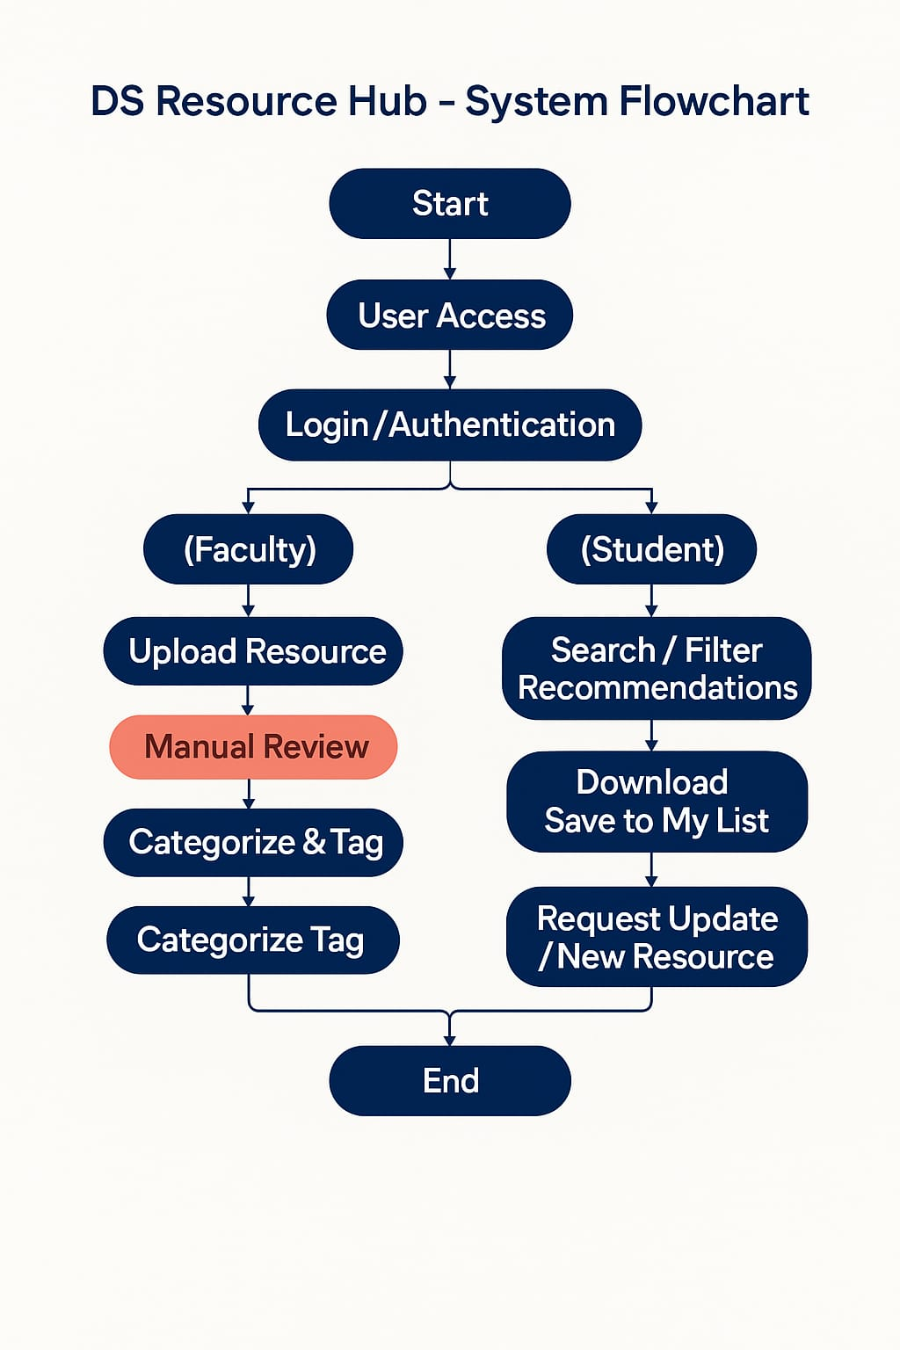
Architectural Design Flow

Slide 8
PROBLEM STATEMENT
To design a centralized web-based resource hub that addresses the issues of scattered academic materials, inefficient access, and poor organization of previous year question papers, project titles, and syllabi in the Data Science department.

Slide 9
Tools And Technology
Languages: Python, HTML, CSS
Frameworks: Django (backend) / CSS (frontend)
Database: SQLite
Libraries: Django
Tools: VS Code

Slide 10
EXPECTED OUTCOME
A fully functional centralized web portal for managing academic resources.
Secure upload and access for both students and faculty.
Improved coordination and collaboration within the department.
A step toward digitally transforming academic resource management.

Slide 11
Thank You!!!

